Slide 1

Executive Branch of Government
Hasan Muhammad Baniamin

Slide 2
Executive
In ancient times the executive (monarch) used to formulate and implement laws.
In modern time, particularly in the democracy, the laws are made by the legislature, the executive implement them.

Slide 3
Two key concepts
Head of the state: formally represents the people of the nation.
Head of government: ho is the leader or "in charge" of the system of creating and executing laws

Slide 4
Types of executive
Nominal and Real Executive: In many countries the head of the state has nominal power as in Great Britain, Sweden. Power of Monarch are exercised by the ministers. Contrary to this, US president has given many powers under constitution (real executive).
Single and Plural Types of Executive: Single executive means that all executive powers are vested in one Head of the State (e.g. the US president exercise all the executive powers). In Switzerland, the executive power is not in the hands of only one individual, but in the hands of a Council of seven members (Federal Council).
Hereditary and Elective Executive: When a king is the head of state and when after his death, his son or his near occupies the throne – called Hereditary executive. Where the Head of State is elected either by the people or by their representative, the system is called Elected executive.

Slide 5
Types of executive
In democracy:
  Within the liberal democracies, governments tend to be either parliamentary or presidential
  Parliamentary executive consisting of Prime Minister, Cabinet Ministers and Junior Ministers;
  Presidential executive consisting of the President and his Cabinet;
  Hybrid system that includes elements of parliamentary and presidential executive and it is found in France;
In dictatorship: When the entire powers of a nation are in the hands of a person.

Slide 6
Function of the executive
Leadership: In the contemporary political world, political leadership is almost always associated with chief executives.
Administrative: maintenance of law and order and other administrative tasks.
Legislative: generally law making is the responsibility of the legislature but in every country, the executive also play an important role to formulate laws.
Military functions: in any crisis, the executive branch perform military functions.
Financial functions: maintain national finance- prepare budget and implement that.

Slide 7
Bangladesh
In Bangladesh, the work of the executive branch of the government is performed by two distinct sets of people:
  Politicians; and
  Permanent officials
Bangladesh has parliamentary system (Westminster style), the party/party alliance which gets the majority of the vote form the government.
Political heads i.e. Ministers lead different ministries.
Permanent officials are known as bureaucracy and they are under the political controls and provide support to the ministers to run the ministry.
Currently Prime Minister and her 25 Cabinet Ministers, 7 Advisers, 18 State Ministers and 3 Deputy Ministers are leading different ministries.
Under Prime Minister, there are multiple ministries, for more: https://cabinet.gov.bd

Slide 8
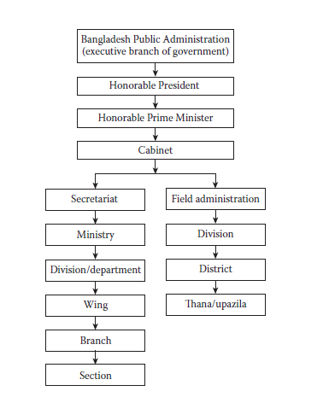
Structure of Bangladesh Public Administration

Slide 9
Current central and field administration
58 Ministries & Divisions
353 Directorates & Others
8 Divisions
64 Districts
492 Upazila
4,554 Unions

Slide 10
Central Administration
  Cabinet Secretary of Bangladesh (Head of the Cabinet Division, and Head of the Bangladesh Civil Service)
  Principal Secretary (this grade is for the Head of the Prime Minister's Office, and equivalent in stature to the Cabinet Secretary)
  Senior Secretary (awarded to secretaries in the most important ministries and departments, as well as for long and distinguished service to the government)
  Secretary (usually the head of a ministry, or in some cases Divisions within important ministries)
  Additional Secretary
  Joint Secretary
  Deputy Secretary (also the usual rank of a Private Secretary (PS) to a Minister; or Secretary in a Ministry and/or Division or Deputy Director of departments under the ministry)
  Senior Assistant Secretary
  Assistant Secretary

Slide 11
Field Administration
  Divisional Commissioner- Division level
  Additional Divisional Commissioner-Division level
  Deputy Commissioner- District level
  Additional Deputy Commissioner (ADC) (Senior Assistant Secretary, senior scale)- District level
  Upazila Nirbahi Officer (UNO) (Senior Assistant Secretary)- Upazila level
  Senior Assistant Commissioner (NDC/RDC)
  Assistant Commissioner (Land)
  Assistant Commissioner (Probation)

Slide 12
Cadre and Non-Cadre
Cadre services were those which were constituted under law with a number of positions, a distinct hierarchy, and well-defined functions for each steps in the hierarchy. Recruitment to the cadre services is normally made through the public service commission on the basis of open competitive examinations and /or interviews.
On the other hand Non-cadre services were mostly based on positions with no definite/limited structure of mobility either horizontally or vertically.
Members of the cadre service could move from one department to another, whereas the non-cadre personnel had to serve in the particular department to which they were originally recruited.
Currently there are 28 cadre services in Bangladesh; BCS (Economic) cadre recently merged with BCS (Administration).
There 20 different grades and BCS cadres start their job from 9th grade and gradually move up.

Slide 13
Gazetted officer and non-gazetted
Gazette is the official paper or journal issued by the state or government.
An employee is treated as gazetted when his/her appointment and promotions are notified in the official gazettes.
There is recruitment on many posts by attached department/semi-government organizations/autonomous bodies which are done by those organizations themselves and those are also termed as government officers but their entry into government service is not notified in the gazette.

Slide 14
Suggested readings
Danziger, J. N., & Smith, C. A. (2016). Understanding the political world: A comparative introduction to political science. Boston :Pearson, pp. 137-144.
Agarwal, R. C. (2014). Political Theory: Principles of Political Science (New Delhi: S. Chand and Company Limited). (Chapter 24).

Slide 15
Q?

